Slide 1

Chatbot for FAQ using NLP with ML
A Presentation on
Dr. D. Y. Patil Pratishthan's College of Engineering, Kolhapur.
By:
Akash Anil Sakhare
Avinash Shashikant Katte
Sumedh Brijesh Sarnaik
Zaid Kausar Nandaniwala
Manav Deepak Chawla
Under the Guidance of
Prof. Ganesh I. Rathod

Slide 2
Contents:
Abstract
Introduction
Literature Survey
Proposed System
Problem Statement
System requirements
Software Requirement
System Implementation
Conclusion
References

Slide 3
Abstract: The “Chatbot for FAQ using NLP with ML” project aims to have always been queries of people regarding various topics to which answers are provided manually by people. In order to make this process fast the FAQs can be answer using the latest AI Technologies where answers can be automatically generated according to the questions. Also, for every question asked it can be stored and the list of questions can be increased to provide better mapping of question and answers. This process can reduce lot of work pressure for both the consumer and the government. Also providing quick responses and suggestions can help in the better Economical market growth.

Slide 4
Introduction: In today's fast-paced world, businesses and organizations often receive a large number of frequently asked questions (FAQs) from their students, employees. Answering these questions promptly and accurately is essential for providing excellent student experience for creating enthusiasm. However, it can be a daunting task for student coordinators to handle such a volume of inquiries efficiently. This is where a chatbot powered by Natural Language Processing (NLP) with Machine Learning (ML) techniques comes into play. A chatbot is an automated conversational agent that interacts with users in a human-like manner. By leveraging NLP, the chatbot can understand and interpret natural language input from users, enabling it to provide appropriate responses to their queries. ML algorithms, on the other hand, allow the chatbot to learn from data and improve its performance over time.

Slide 5
Literature Survey
Nowadays it is the era of intelligent machine. With the advancement of artificial intelligent, machine learning and deep learning, machines have started to impersonate as human
Extracted knowledge will be used as training dataset for building a Neural Network Conversational Agent
To integrate these goals, applying deep reinforcement learning to model future reward in chatbot dialogue
There is a growing interest in chatbots, which are machine agents serving as natural language user interfaces for data and service providers.

Slide 6
Proposed System
System overview
Data Acquisition
Data Preprocessing
Analysis for NLP Chatbots
-Accuracy & Understanding
-Natural Language Generation
Insights for Recommendation for NLP Chatbot
Continues Improvement

Slide 7
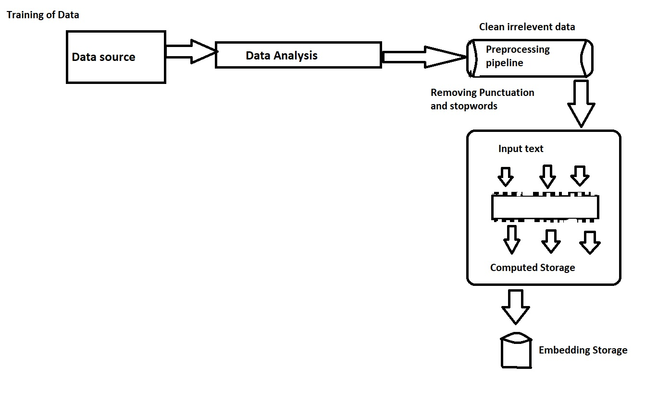
Training of Data

Slide 8
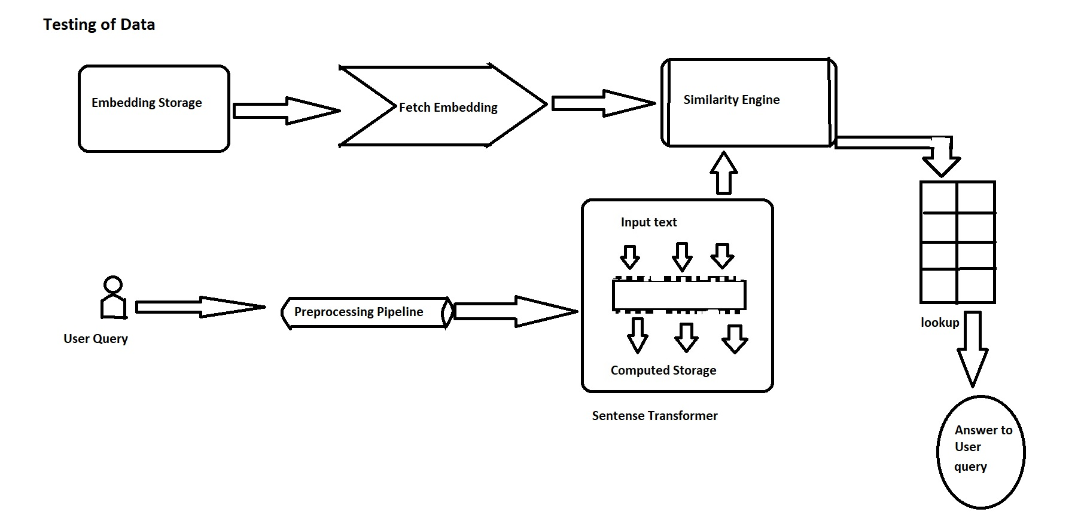
Testing of Data

Slide 9
Problem Statement:
Message Interpreting - Machine understanding the intention of user
Machine to Human Transition – Communication gap between Machine and Human
Data Gathering - As user requirement like organization, Company
Natural Language Processing (NLP) – Customizations and Adjustments with respect to NLP

Slide 10
^{System Requirement:}
Memory and disk space required per user: 1GB RAM + 1GB of disk + 5 CPU core.
Server overhead: 2-4GB or 10% system overhead (whatever is larger), 5 CPU cores, 10GB disk space.
Port requirements: Port 8000 plus 5 unique, random ports per notebook
Software :-
Windows 7 and above.
Jupiter Notebook (Anaconda 3)
Python 3.7.2 +

Slide 11
System Implementation
Gather data for FAQ’s.
Pre-processing of gathered data.
Perform tokenization on data.
Perform stemming or lemmatization
Perform PoSTags (Parts of speech tags)
Provide Name Entity Recognition
Perform chunking on processed data

Slide 12
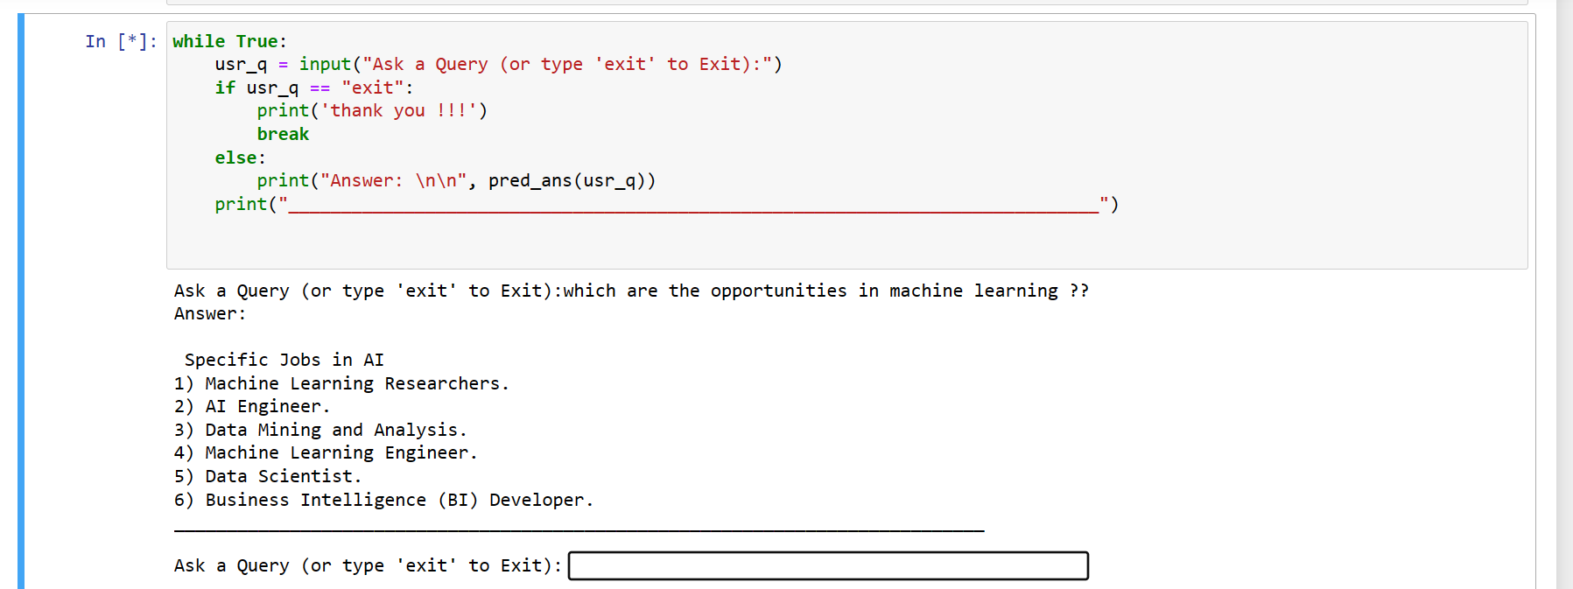
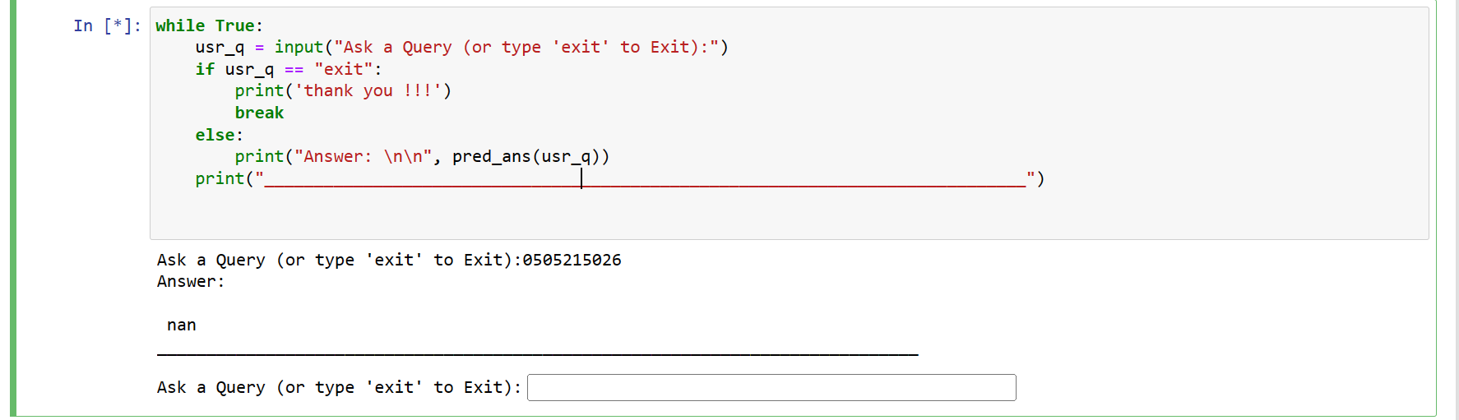

Slide 13
Conclusion:
In conclusion, the "Chatbot for FAQ using NLP with ML" project has provided Relevant Answers from the Dataset the patterns and trends within Chatbot. Through careful analysis of the dataset, several key findings have emerged: There are always been queries of people regarding various topics like Machine Learning to which answers are provided manually by people. In order to make this process fast the FAQs can be answer using the latest NLP and ML technologies where answers can be automatically generated according to the questions. Providing quick responses and answers about specific topic using chatbots, It can be useful better experience of user and organizations to increase their attachments with user and it also improves Market growth.

Slide 14
References:
Nuruzzaman, M.; Hussain, O.K. A Survey on Chatbot Implementation in Customer Service Industry through Deep Neural Networks. In Proceedings of the 2018 IEEE 15th International Conference on e-Business Engineering (ICEBE), Xi’an, China, 12–14 October 2018; pp. 54–61.
S. Arsovski et al., Automatic knowledge extraction of any chatbot from conversation, Expert Syst. With Appl. 137 (2019), 343– 348.
Li, J.; Monroe, W.; Ritter, A.; Galley, M.; Gao, J.; Jurafsky, D. Deep Reinforcement Learning for Dialogue Generation. arXiv 2016, arXiv:1606.01541.
Brandtzaeg, P.B.; Følstad, A. Why People Use Chatbots. In Internet Science; Kompatsiaris, I., Cave, J., Satsiou, A., Carle, G., Passani, A., Kontopoulos, E., Diplaris, S., McMillan, D., Eds.; Lecture Notes in Computer Science; Springer International Publishing: Berlin/Heidelberg, Germany, 2017; Volume 10673, pp. 377–392.

Slide 15
Thank You

